Slide 1
Tobacco alcohol and other drug use (TAD) 2007 - 2017
Youth Risk Behavior Surveillance System (YRBSS):
Final Capstone presentation
Anitha Pissay
March 2020

Slide 2
BACKGROUND
YRBSS was developed in 1990 to monitor health behaviors that contribute markedly to the leading causes of death, disability, and social problems among youth and adults in the United States. These behaviors, often established during childhood and early adolescence, include
Behaviors that contribute to unintentional injuries and violence.
Sexual behaviors related to unintended pregnancy and sexually transmitted infections, including HIV infection.
Unhealthy dietary behaviors.
Inadequate physical activity.

Slide 3
introduction
Use of Tobacco, Alcohol and other Drug significantly affects the youth risk behaviors.
Data science utilises digital technologies and computational algorithms to effectively analyse the data in novel ways
Large data set analysis will be able to pick up important trends on the use of TAD and correlation between age groups, sex and the type of abusive substance, which are often incomprehensible by manual analysis.
Understanding the trends in use of TAD helps in developing intervention measures such as change in policies, creating guidelines to schools, community awareness programs to reduce the behavioral risks at an early stage.

Slide 4
objectives
Large data analysis using R programming to evaluate the trend in TAD usage among high-school students over a period of 10 years from 2007-2017.
Evaluation of the trends amongst
# Smokers vs Non-Smokers; Alcohol Users vs Non-Users ; Drug abuse vs Non-Drug use
Evaluate the gender bias on the TAD usage
Changes in trends of TAD usage amongst
9th to 12th Graders and
kids aged 13 years and less
Use of E- cigarettes
Trend in use of various drug substances
Draw conclusions based on the results generated.

Slide 5
Data source
From 1991 through 2017, the YRBSS has collected data from more than 4.4 million high school students in more than 1,900 separate surveys in the United States.
My project primarily focuses on Tobacco, Alcohol and other drug Use (TAD) from 2007 to 2017
The Data sets were downloaded from “Center for Disease Control and Preventions” (CDC).
Over 80,000 validated responses were used for the Data Analysis.

Slide 6
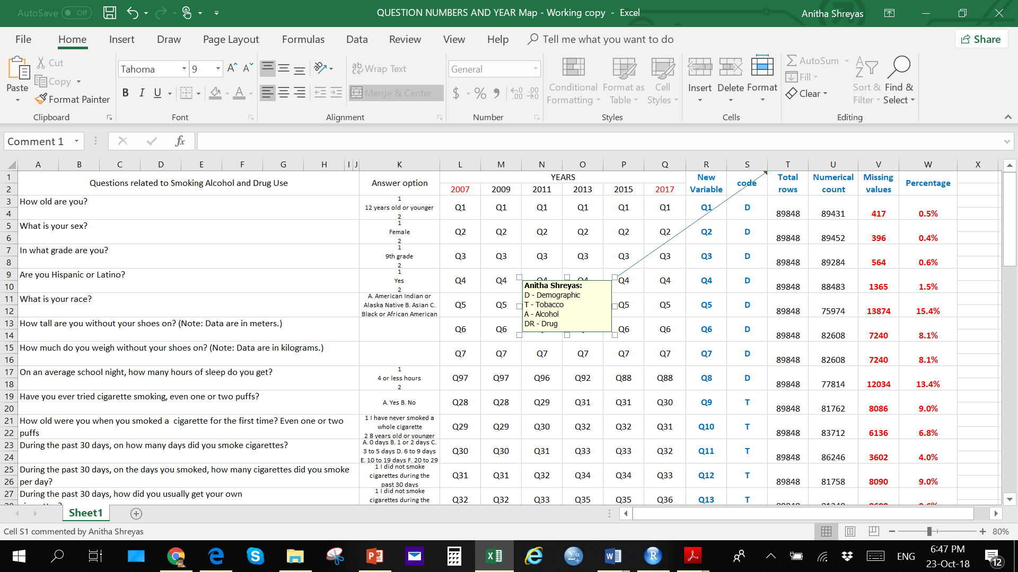
Data set
As the area of focus was narrowed to only 3 behaviors – TAD, only the responses of the questions related to them were extracted along with the demographic data such as students age, gender, grade etc,.
An extra variable (YEAR) that did not belong to any of the datafiles was created to identify the year from which the data was being extracted.

Slide 7
Exploratory data analysis TOBACCO USE – SMOKING ALCOHOL OTHER DRUG USE
BASED ON
NUMBERS
SEX
GRADE
13 YEARS AND UNDER

Slide 8
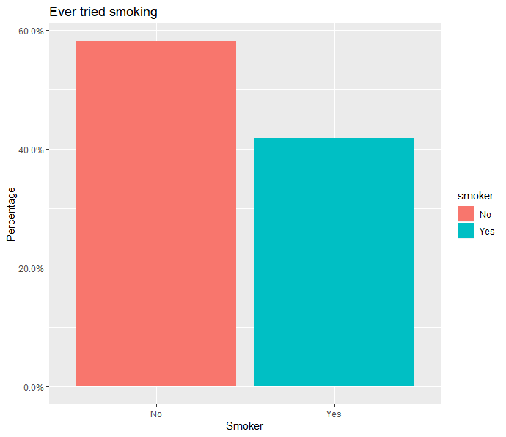
Tobacco use (2007 – 2017)
Smokers vs Non-Smokers
SMOKER | COUNT | %
No | 47535 | 58.1
Yes | 34227 | 41.9
Based on the Data collected 2 in every 5 High Schooler is a SMOKER spanning over the last decade.

Slide 9
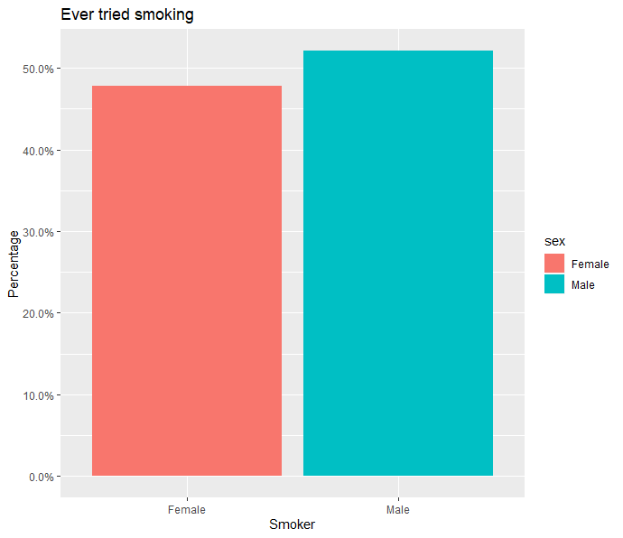
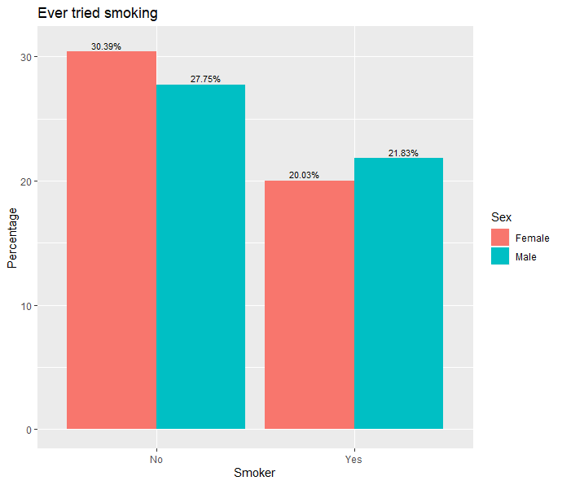
Tobacco use: grouped by Sex
SEX | COUNT | %
Female | 16309 | 47.8
Male | 17777 | 52.2
% of male and female Smokers
% of male and female Non-Smokers vs Smokers
There is no significant difference seen in smoking habits withing sex, although number of female Smokers are less.

Slide 10
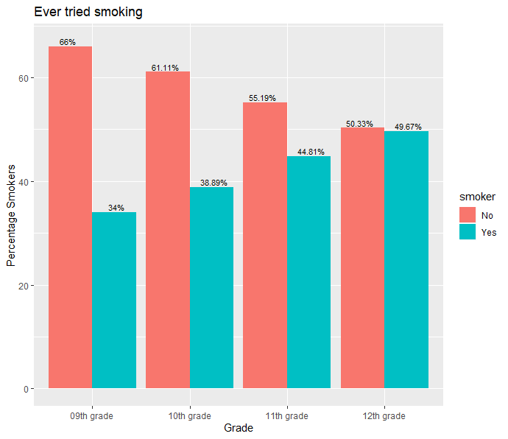
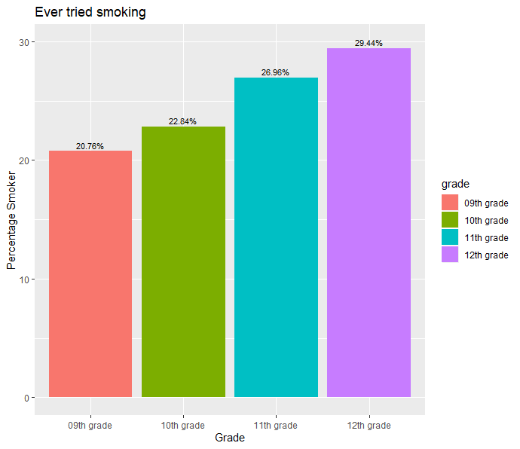
Tobacco use: grouped by Grade
GRADE | COUNT | %
9th | 7045 | 20.8
10th | 7750 | 22.8
11th | 9151 | 27.0
12th | 9991 | 29.4
% of Non-Smokers vs Smokers across Grades
% Smokers across Grade
As the grade increases the gap between Smokers and Non-Smokers in each grade is decreasing eventually with almost no difference
11th and 12th Graders % of Smokers were significantly higher compared to 9th and 10th Graders

Slide 11
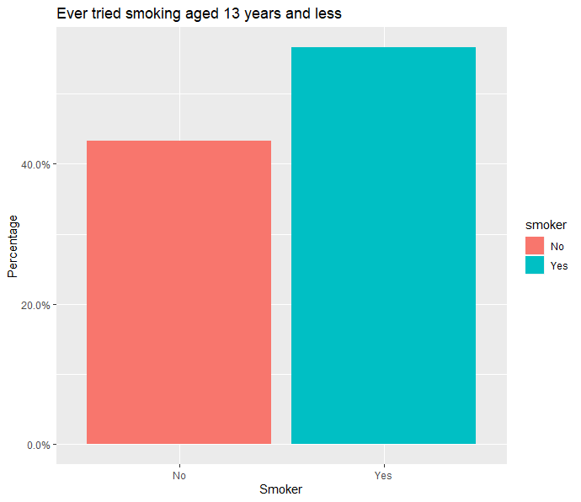
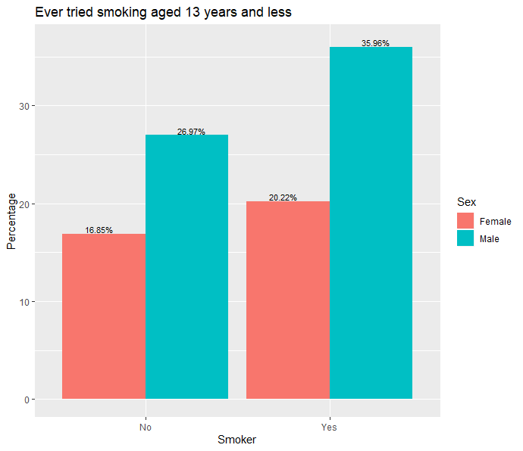
Tobacco Use: Aged 13 years and below
% of Non-Smokers vs Smokers
% of Non-Smokers vs Smokers by sex
SMOKER | COUNT | %
No | 39 | 43
Yes | 51 | 57
When grouped for Smokers and Non-Smokers below the age of 13, there is an alarmingly higher percentage of Smokers in this age group
When Smokers and Non-Smokers below the age of 13 are grouped for sex, there is a higher percentage of male Smokers compared to female Smokers.
The number of data collected is low, hence distinct conclusions would not be ideal
Although, more preventive actions by educating the adverse effects should be carried out at the early age.

Slide 12
Overall summary of tobacco use in High School Students
Smokers
By Sex
By Grade
13 Years & below

Slide 13
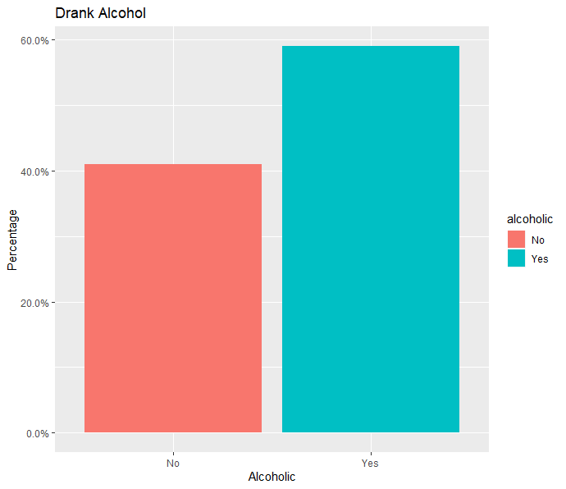
alcohol use (2007 – 2017)
Alcoholics vs Non-Alcoholics
ALCOHOLIC | COUNT | %
No | 50469 | 59
Yes | 35062 | 41
Similar to Tobacco use, 2 in 5 students are Alcoholics

Slide 14
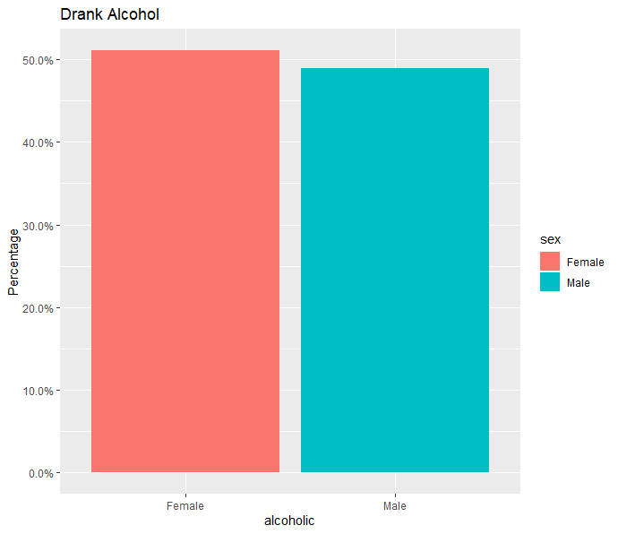
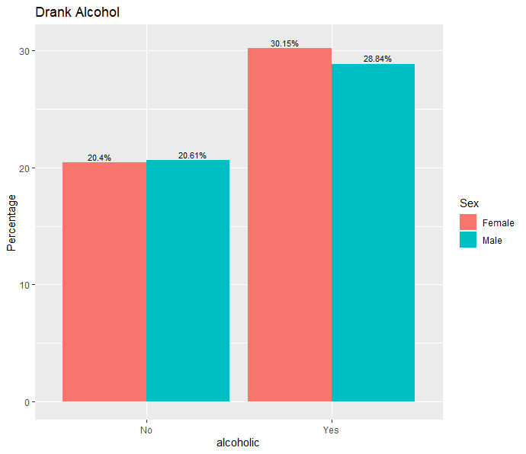
Alcohol use: grouped by Sex
SEX | COUNT | %
Female | 25684 | 51.1
Male | 24566 | 48.9
% of male and female Alcoholics
% of male and female Non-Alcoholics vs Alcoholics
There is no significant difference seen in Alcoholic habits withing sex, although number of female Alcohol users are higher

Slide 15
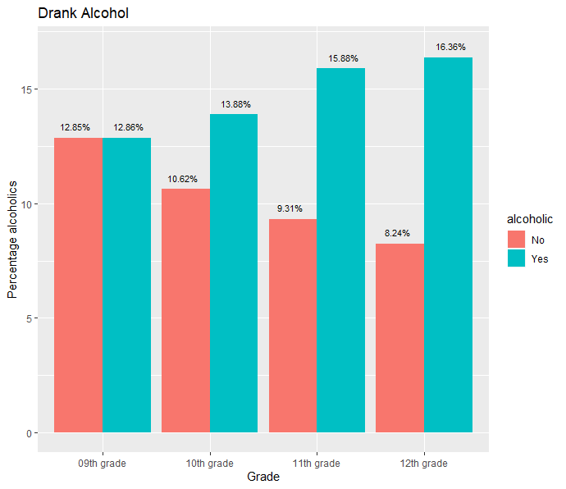
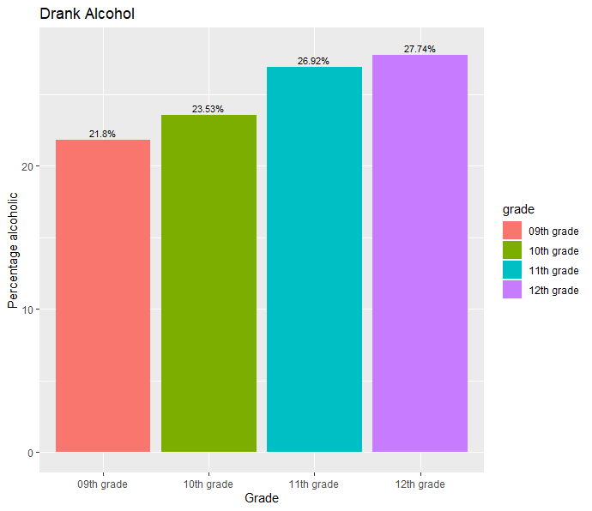
Alcohol use: grouped by Grade
GRADE | COUNT | %
9th | 10919 | 21.8
10th | 11785 | 23.5
11th | 13483 | 26.9
12th | 13892 | 27.7
% of Non-Alcoholics vs Alcoholics across Grades
% Alcoholics across Grade
Higher the Grade, Higher the percentage of Alcoholics.
As the grade increases the gap between Alcoholics and Non-Alcoholics in each grade is increasing

Slide 16
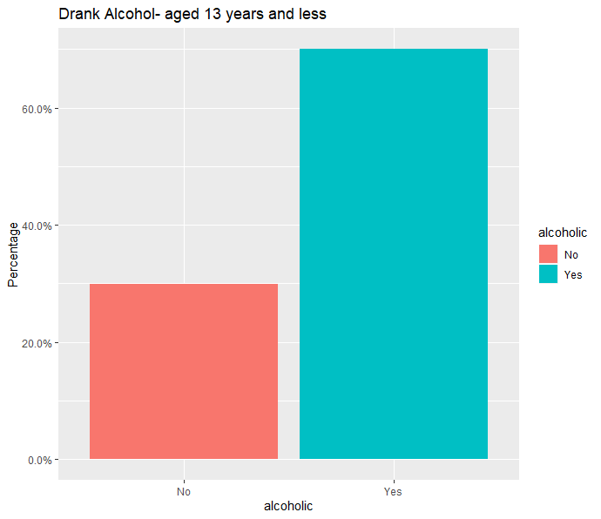
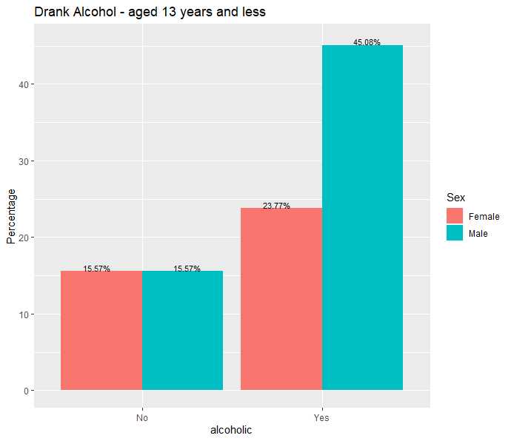
ALCOHOL Use: Aged 13 years and below
% of Non-Alcoholics vs Alcoholics
% of Non-Alcoholics vs Alcoholics by sex
ALCOHOLIC | COUNT | %
No | 38 | 30
Yes | 89 | 70
When grouped for Alcoholics and Non-Alcoholics below the age of 13, there is an alarmingly higher percentage of Alcoholics of 70% in this age group
When Alcoholics and Non-Alcoholics below the age of 13 are grouped for sex, there is a higher percentage of male Alcoholics compared to female Alcoholics.
The number of data collected is low, hence distinct conclusions would not be ideal
This behavior needs to be nipped at the bud to see positive change at a higher age group.

Slide 17
Overall summary of ALCOHOL USE in High School Students
Alcoholics
By Sex
By Grade
13 Years & below

Slide 18
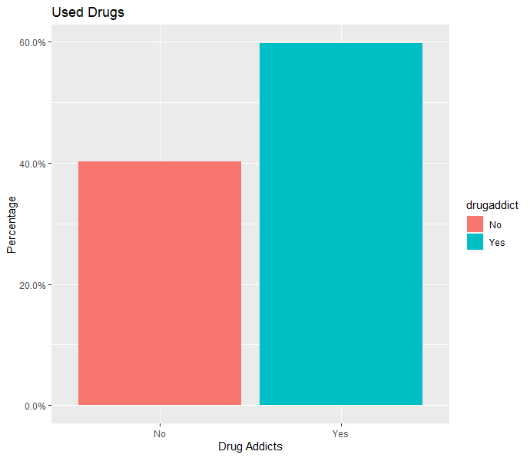
drug use (2007 – 2017)
Drug Users vs Non-drug Users
USED DRUG | COUNT | %
No | 31116 | 40
Yes | 46215 | 60
The percentage of Drug Users are significantly higher when compared to Non-Drug Users.

Slide 19
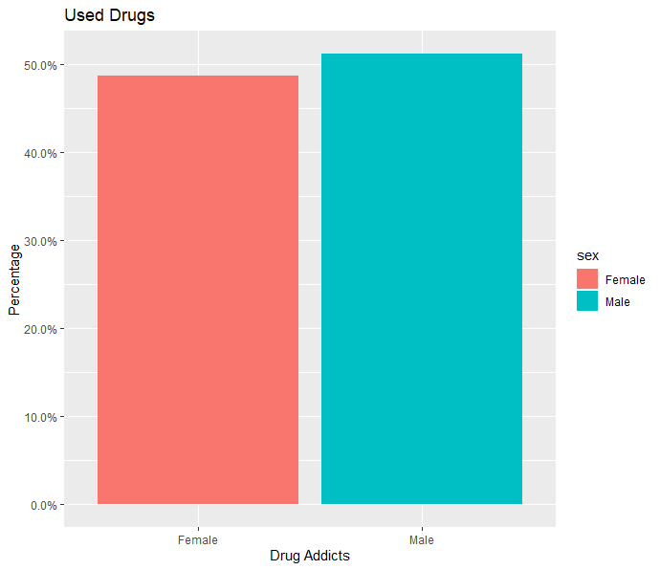
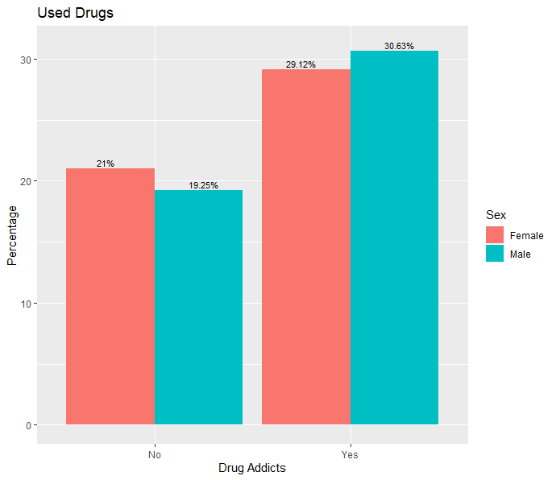
drug use: grouped by Sex
SEX | COUNT | %
Female | 22412 | 48.7
Male | 23579 | 51.3
% of Drug Users by Sex
% of Drug Users vs Non-Drug Users by sex
There is no difference in the proportions of Male and Female Non-Drug Users.
The percentage of Drug Users are almost the same in both sex

Slide 20
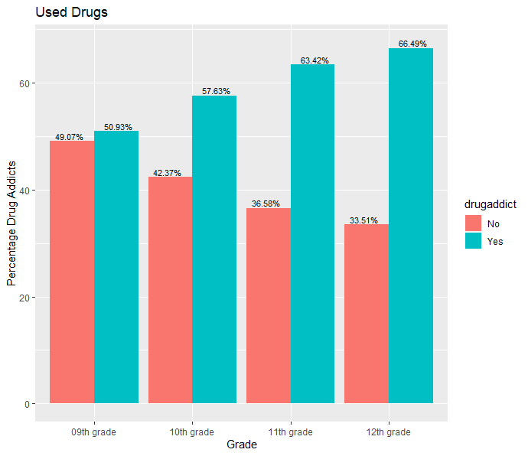
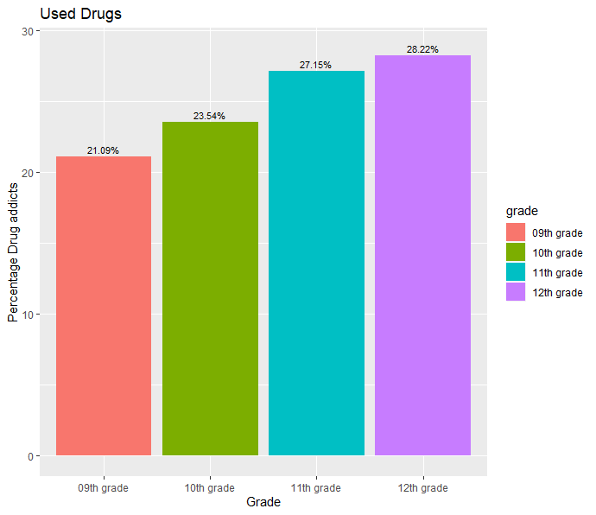
drug use: grouped by Grade
GRADE | COUNT | %
9th | 9660 | 21.1
10th | 10783 | 23.5
11th | 12437 | 27.2
12th | 12928 | 28.2
% of Drug Users vs Non-Drug Users across Grades
% Drug Users across Grade
As the grade increases the gap between Drug Users and Non-Drug Users in each grade is increasing
Similar to tobacco and alcohol use, drug use also shows that “higher the grade, higher the % of users”.

Slide 21
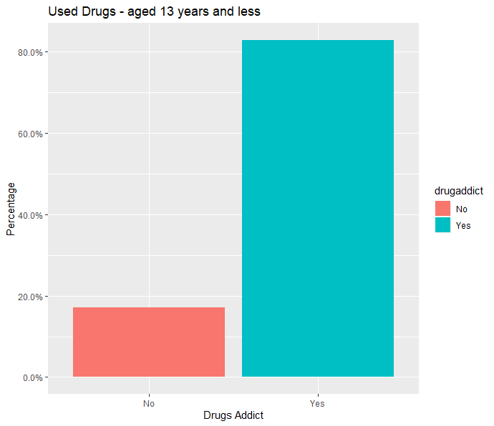
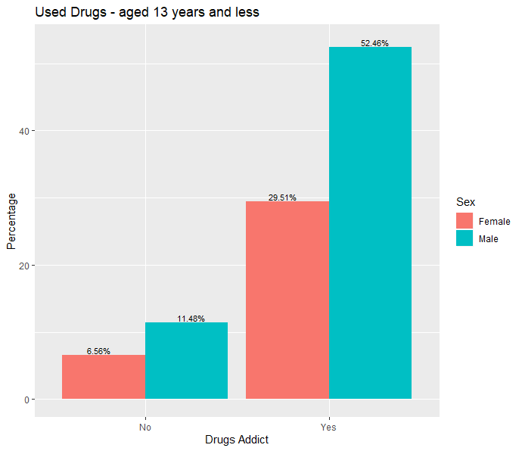
drug Use: Aged 13 years and below
% of Non-Drug Users vs Drug Users
% of Non-Drug Users vs Drug Users by sex
USED DRUG | COUNT | %
No | 22 | 17
Yes | 107 | 83
When grouped for Drug Users of all kind, below the age of 13, there is an alarmingly higher percentage of Drug Users of more than 80% in this age group
When Drug Users below the age of 13 are grouped for sex, there is a higher percentage of male Drug Users as compared to female Drug Users.
The number of data collected is low, hence distinct conclusions would not be ideal
A greater awareness campaign should be implemented to see changes.

Slide 22
Overall summary of drug USE in High School Students
Drug Users
By Grade
13 Years & below
By Sex

Slide 23
Time series analysis 2007 -2017
TOBACCO USE – SMOKING ALCOHOL OTHER DRUG USE

Slide 24
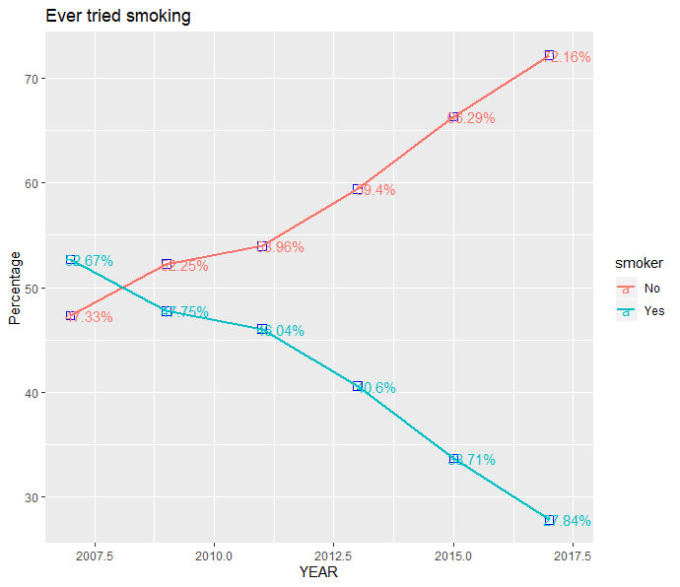
tobacco use
The smoker pattern over ten years shows a decline in percentage on Smokers from 53% in 2007 to 28% in 2017.
The time series trend also show a good increase in percentage of Non-Smokers from 47% in 2007 to 72% in 2017.
This can suggest that effective measures and steps might be showing a positive effect

Slide 25
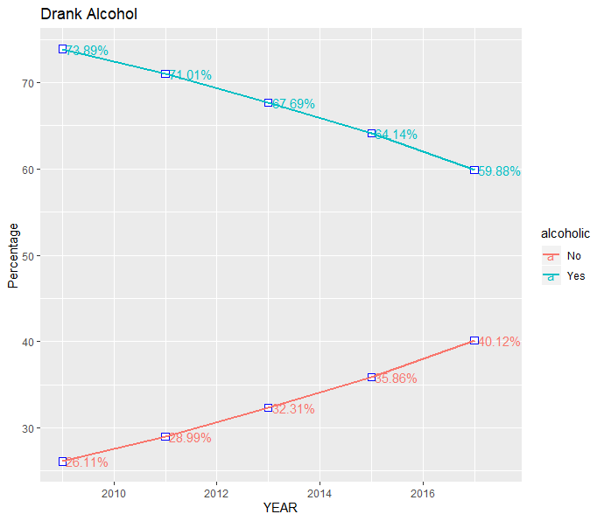
Alcohol use
The Alcohol pattern over ten years shows a decline in percentage on Alcoholics from 74% in 2007 to 60% in 2017.
The time series trend also show a good increase in percentage of Non-Alcoholics from 26% in 2007 to 40% in 2017.
Though there is a decline in the Alcoholics numbers over the years but there is still a significant high percentage of Alcoholics and we need effective measures to reduce this gap.

Slide 26
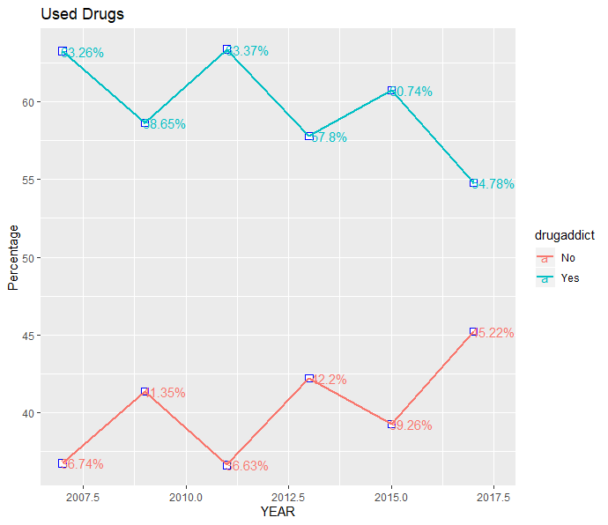
drug use
Studying the Alcohol users pattern over the years does not show any direction percentage increase or decrease.
But when compared between 2007 and 2017 there is a drop in number of users from 63% to 55%.
Whether this drop in numbers is significant needs to be investigated

Slide 27
Usage of Different drugs types
Cocaine, Ecstasy, Glue, Heroin, LSD, Marijuana, Needle, Prescription drugs

Slide 28
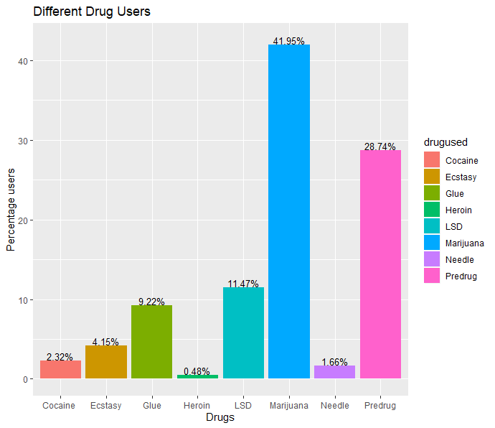
Different drug users
The graph clearly shows that Marijuana is the most popular kind of substance with 42% amongst the youth followed by prescription drugs not prescribed by the doctors which is 29%.
The Least popular substance is Heroin with less than 0.5% users.
This may be due to the availability and cost factors

Slide 29
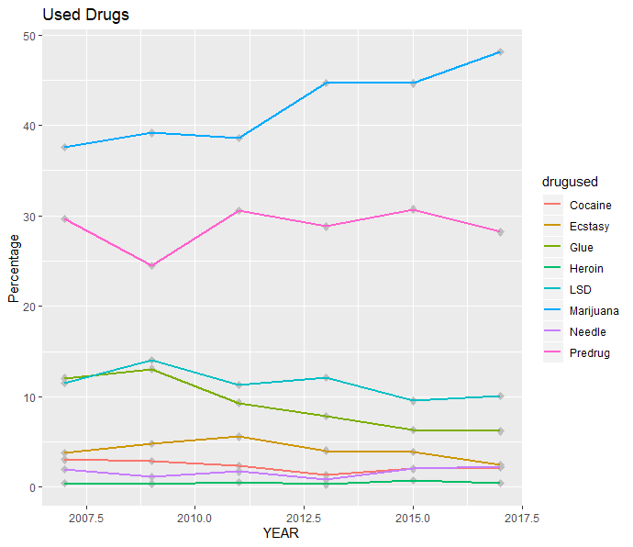
Time Series plot for different drug use : 2007 - 2017
Studying the Different drug users pattern over the years we can conclude the following
The Percentage of Marijuana users have increased over the years from 38% in 2007 to 48% in 2017.
There is no change in the users of Heroin
The percentage of Glue users has decreased from 12% in 2007 to 6% in 2017
No significant difference seen in other kinds of drugs over the years.

Slide 30
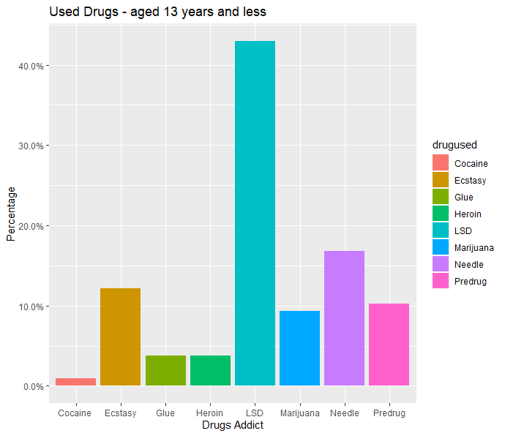
Popular Drug type in students Aged 13 years and below
Contrary to the overall Popular drug type Marijuana among the high schoolers the 13 year olds and less, finds popularity in LSD [Lysergic acid diethylamide] a hallucinogenic drug with a high percentage of users of 46%

Slide 31
Electronic Vapor product users – e-cigarettes (2015 & 2017)
vaping

Slide 32
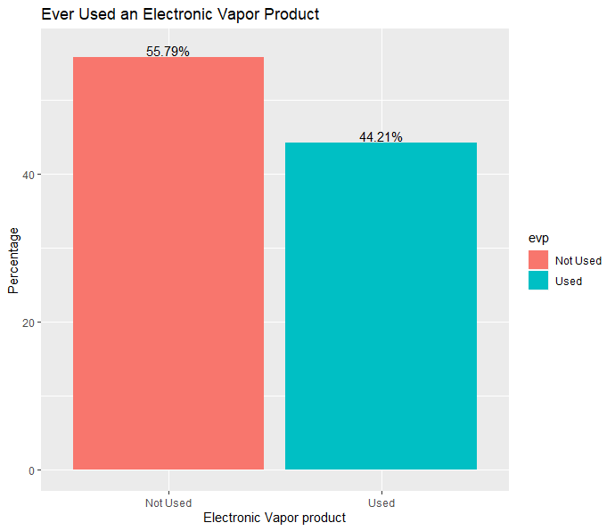
E-Cigarette users
E-CIGARETTE | COUNT | %
NOT USED | 16044 | 55.79
USED | 13360 | 44.21
The new fad in recent years which is taking over the teenagers is the vaping plague.
The data exists only for 2015 and 2017
There is a high percentage of users of this product which is an area of concern

Slide 33
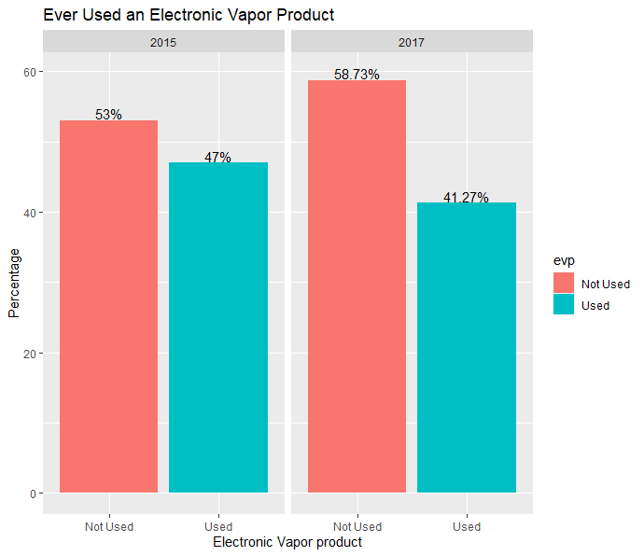
E-Cigarette users
YEAR | E-CIGARETTE | COUNT | %
2015 | NOT USED | 7998 | 53
 | USED | 7093 | 47
2017 | NOT USED | 8406 | 59
 | USED | 5907 | 41
2015
2017
The E-Cigarette users have dropped by 6% between 2015 and 2017
The data and also the timeline is insufficient to draw any conclusions.
We need to gather more information for further investigation.

Slide 34
Summary
Based on the data analysis for the data collected over a period 2007-2017, 2 in 5 high schoolers were smokers and alcoholics.
Not surprisingly, number of drug abuse was higher with 3 out of 5 students.
No significant differences in TAD users grouped by Sex, was noticed
In general, as the grade increased the number of TAD users also increased.
In Students below 13 years, TAD usage was higher, although the number of data points were low, which suggests insufficient data in order to conclude the impact
Analysis of Time Series showed that there is a significant decrease in TAD users over time
Marijuana was the primary choice of drug users compared to other substances.
Whilst, data for E-Cigarettes was only collected from 2015 & 2017, Yet 44% of students used E-cigarettes

Slide 35
Conclusions
CDC findings for Adult TAD users was used to draw comparisons.
Among high schoolers smoking was significantly higher (42%) than adults (14%). 16 in every 100 males and 12 in 100 females were smokers, whilst no differences based on sex was noticed in them.
In general, as the grade increased the number of TAD users also increased. Whereas in adults, younger (18-24 yr) and older ( > 65yr) age groups had lower % of smokers when compared to middle age (24-65) persons.
2 in 5 students were Alcoholics, compared to 1 in 4 in adults. Similar to high-schoolers, adults also showed higher consumption of alcohol until the age of 45(25-35%), it reduces to 22% for age groups of 45-65 years and significantly lower percentage (8%) consumed alcohol at 65.
Overall Time Series Analysis (2007 -2017) showed that there is a significant decrease in TAD users over time.

Slide 36
Recommendations
The Lack of data on E-Cigarettes, limited to just 2 years, showed a declining trend (May be inaccurate) . Hence More data needs to be collected for new trends in E-cigarettes due to its popularity in adolescents in recent years. This will help in better prevention and preparedness methods.
TAD usage in students under 13 years old, is alarmingly high. This could be due to smaller data points. However, early intervention is necessary to educate on adverse effects of TAD use, to create awareness and inculcate good habits.
Drug use was significantly higher than the Tobacco and Alcohol use. This is worrisome, given the severity of impact on health due to addiction. Hence, schools and communities should conduct awareness campaigns for not only students but also parents.
Prevention is better than Cure

